Slide 1
Modeling the NH₃ emission of a naturally ventilated dairy barn - A first analysis of different approaches
Dilya Willink, David Janke, Thomas Amon,
Notes:
1

Slide 2

Why we want to model ammonia emissions?
Well validated & calibrated model can be an alternative approach in estimating ammonia emissions in the the barn instead of using complex and expensive measurement setup (f.e., FTIR);
Validated & calibrated model allows decisions makers/stackholders to develop realistic emissions reduction strategies by tuning different barn characteristics included in the model (f.e., manure quality, emitted surface, age of the manure in the barn etc.) and observing the straightforward consequences of changing of ammonia emissions in the barn resulting of such tuning.
07.02.19
2
Notes:
2

Slide 3
Aims:
To provide a comparison between different ammonia emission models from literature sources (f.e., Bjerk et.al., 2013);
To identify the influence of ambient parameters on the modeling results;
To identify the best model estimating ammonia emissions and possibility to its upscaling to the scale of dairy barn;
Next development of the chosen model in order to fit model to the barn scale (if possible);
Validate the model with measured ammonia emissions (f.e., by FTIR devices; extracted in lab from the sample points).
07.02.19
3
Notes:
3

Slide 4
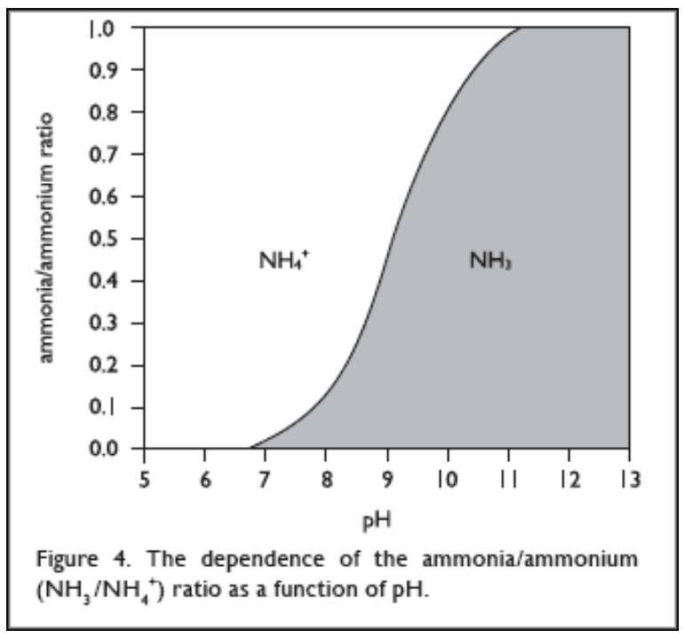
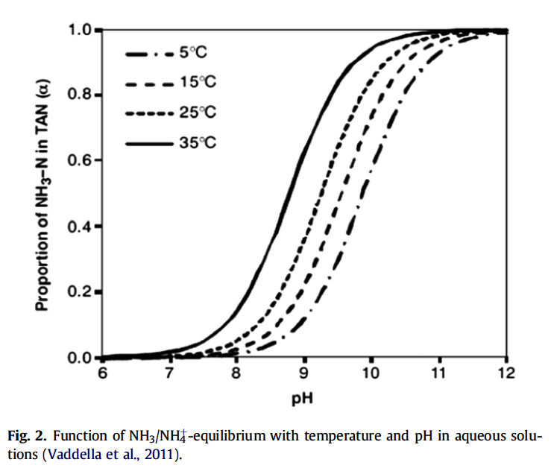
07.02.19
4

Slide 5
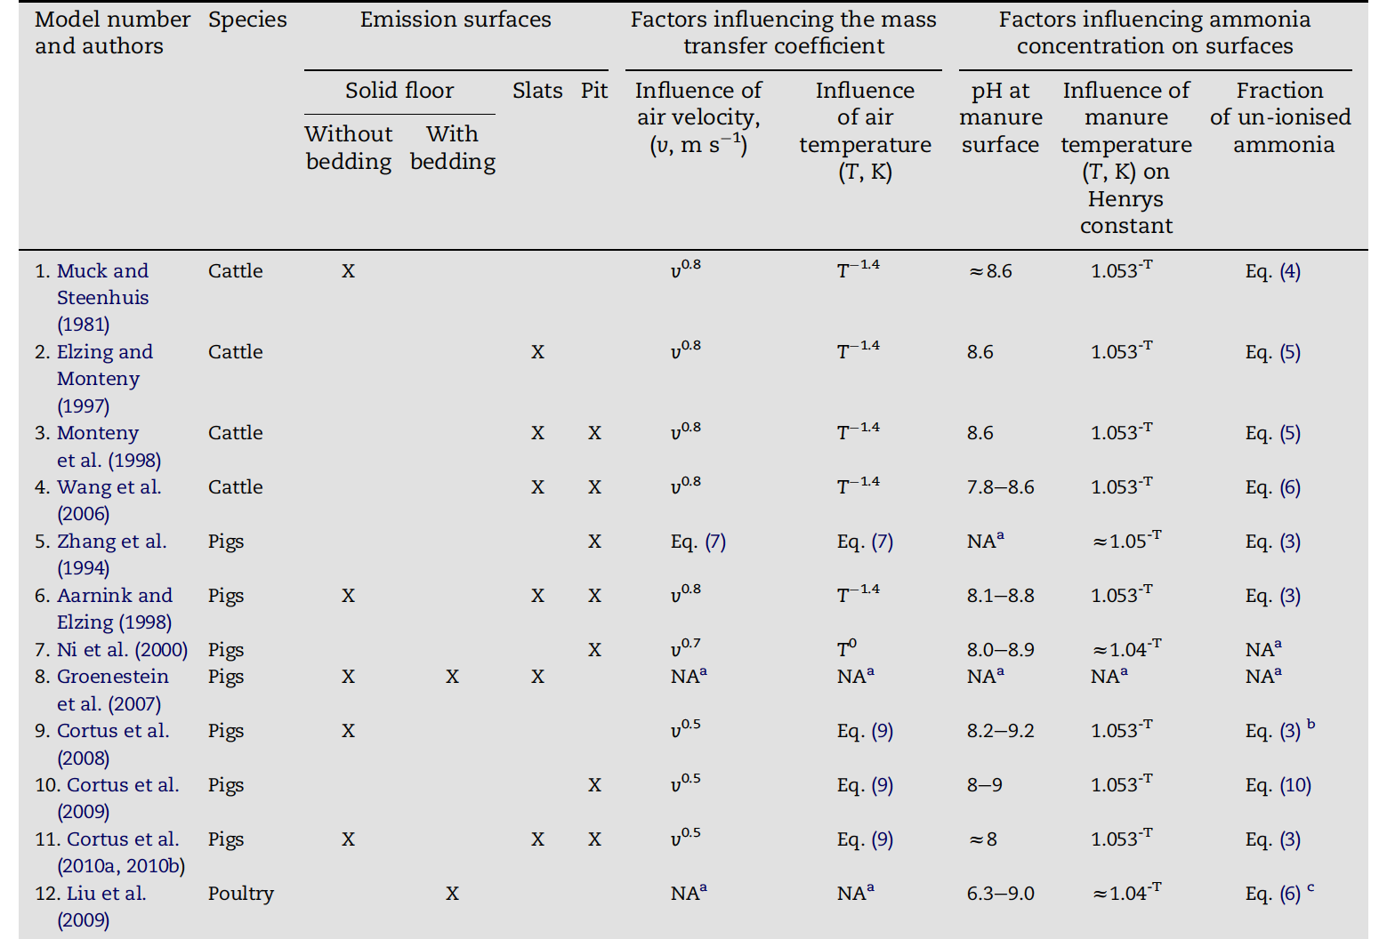
Models description
07.02.19
5

Slide 6
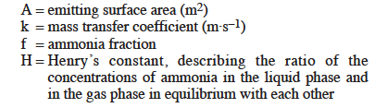
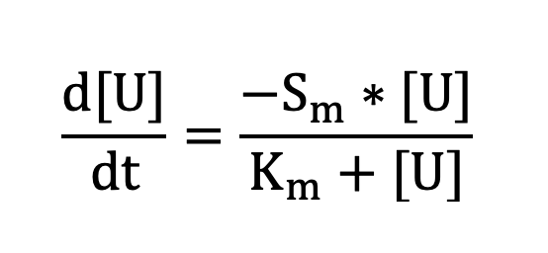
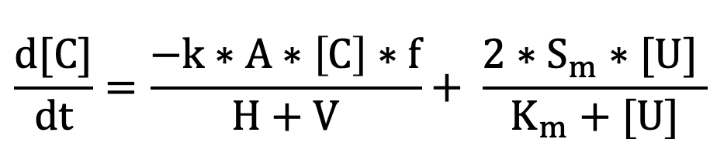
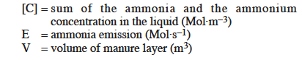
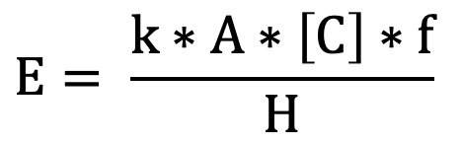
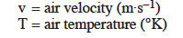
Modelling computation on the example of Model Elzing, Monteny, 1997
07.02.19
6

Slide 7
Measuring experience: Dummerstorf barn, Germany

Slide 8
Which ambient parameters we need to input into Model?
Temperature (two values: air temperature and manure temperature)
Air velocity
Surface area/Volume
pH
Urea concentration
measured
Lab
07.02.19
8

Slide 9
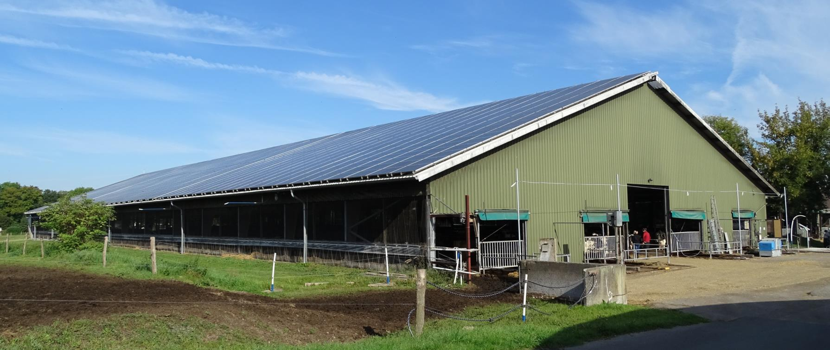
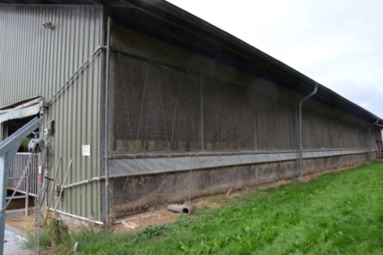
Motivation
11 m
96m
34 m
07.02.19
9
Notes:
9

Slide 10
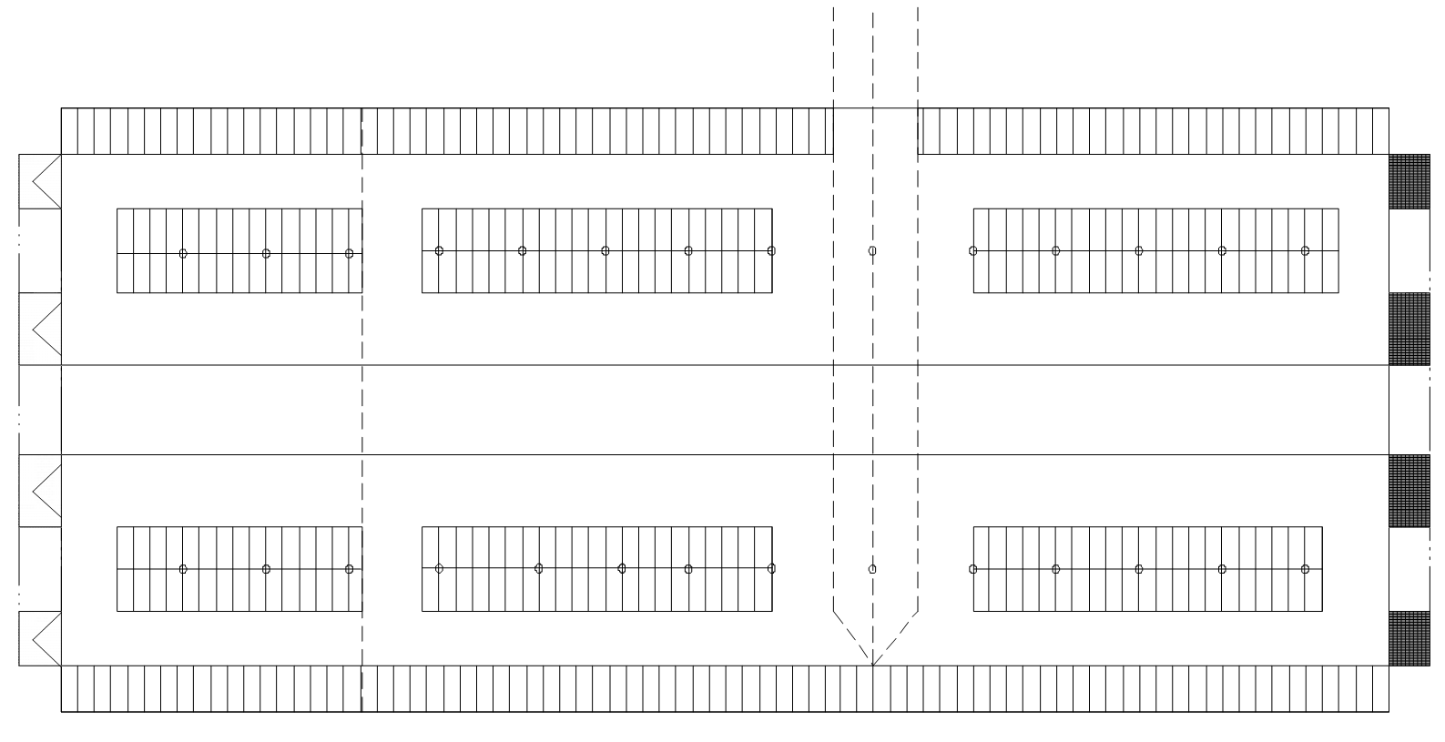
Dummerstorf: sampling measurements plan
Probenahme
Beam
N
8
10
12
7
9
11
I
IV
5
3
6
II
2
III
4
1
S

Slide 11
Ambient parameters:
spatial distribution Dummerstorf barn, Germany

Slide 12
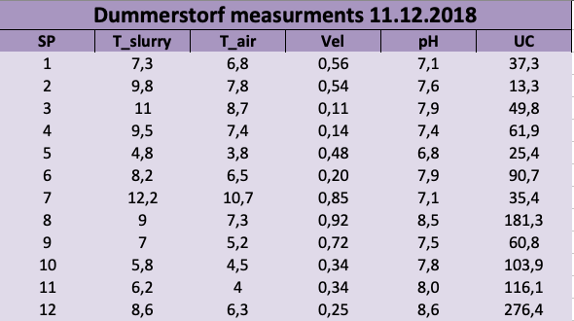
Measurement experience:
07.02.19
12

Slide 13
Modelling experience of ammonia emissions

Slide 14
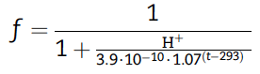
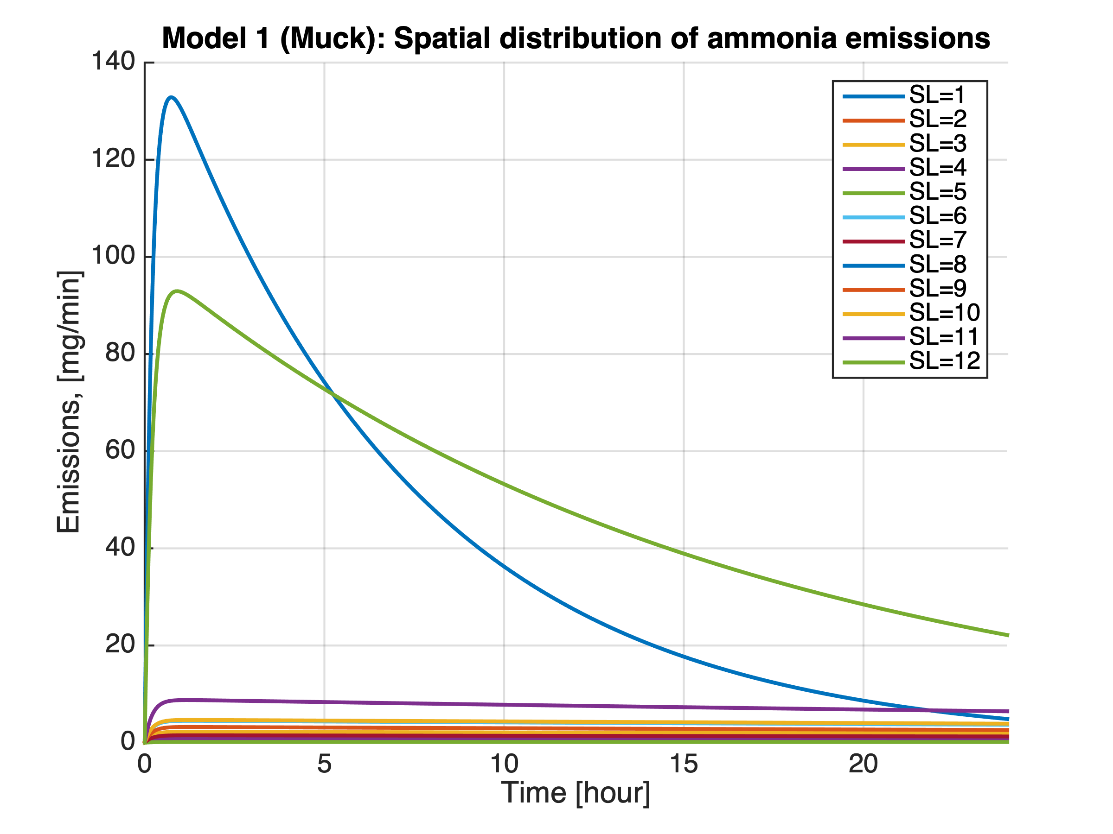
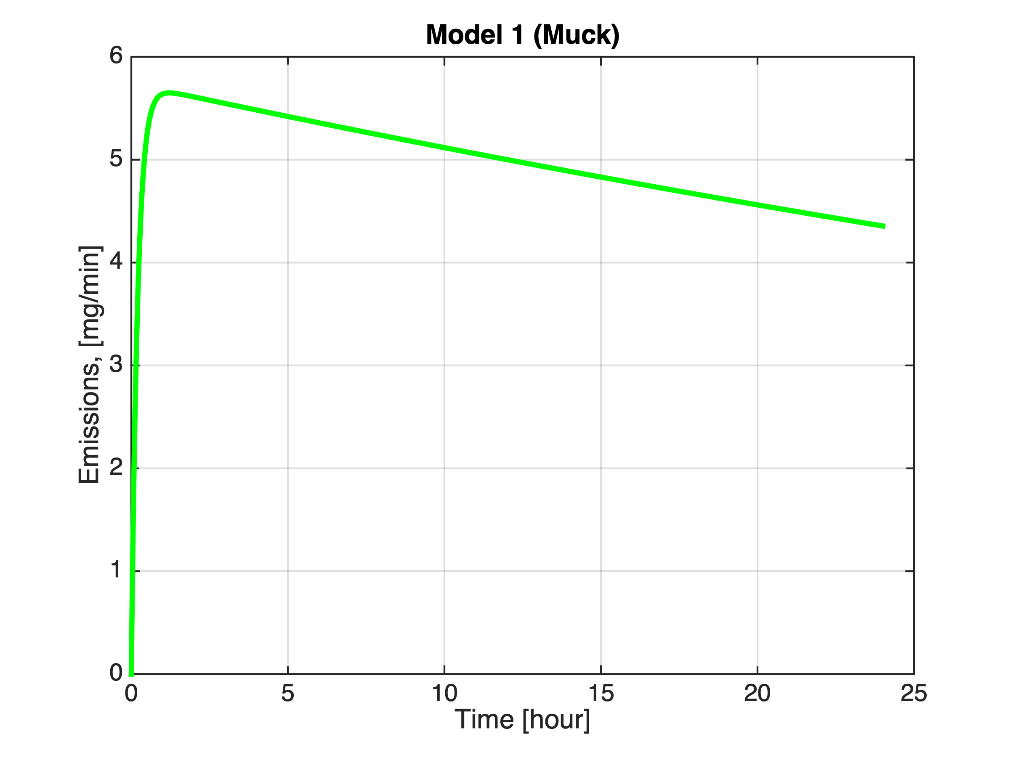
Modelling: Comparison between emissions from different models
Model 1 (Muck, 1981)
T- temperature of manure/slurry (K)
Ammonia Emissions based on averaged ambient parametres
07.02.19
14

Slide 15
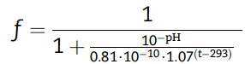
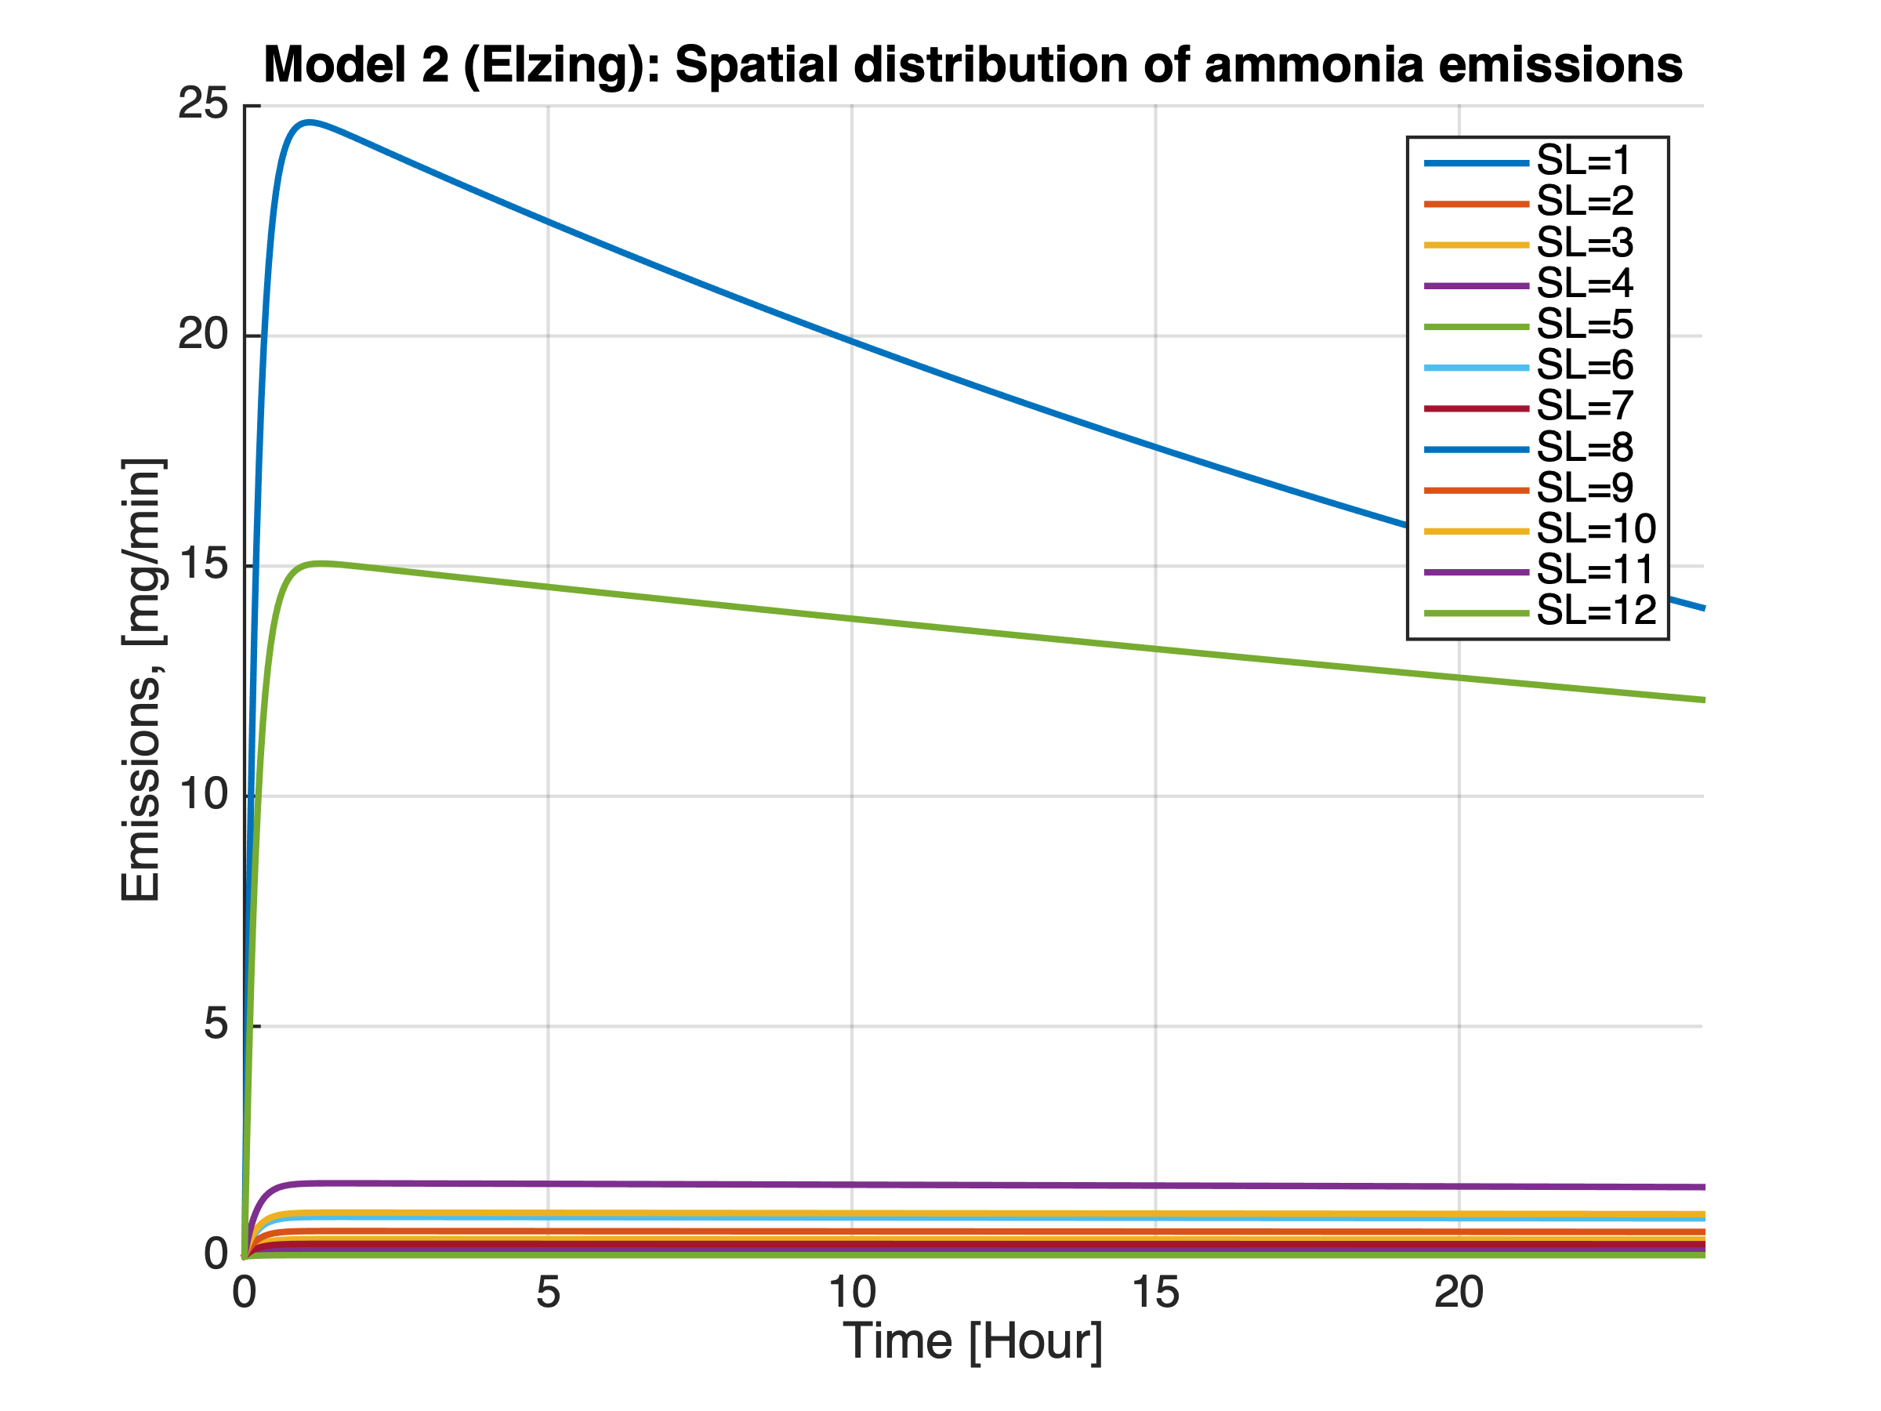
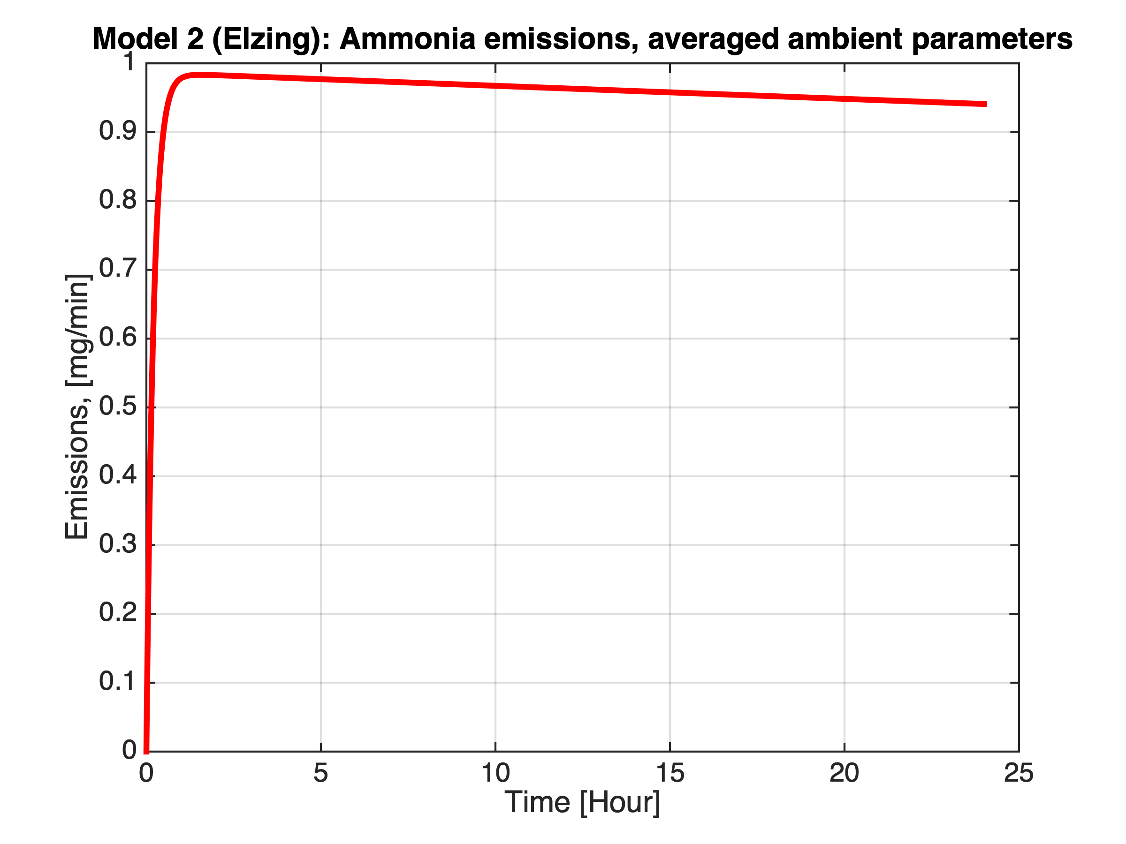
Modelling: Comparison between emissions from different models
Model 2 (Elzing, Monteny, 1997)
T- air temperature (K)
Ammonia Emissions based on averaged ambient parametres
Betriebsdaten
07.02.19
15

Slide 16
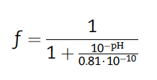
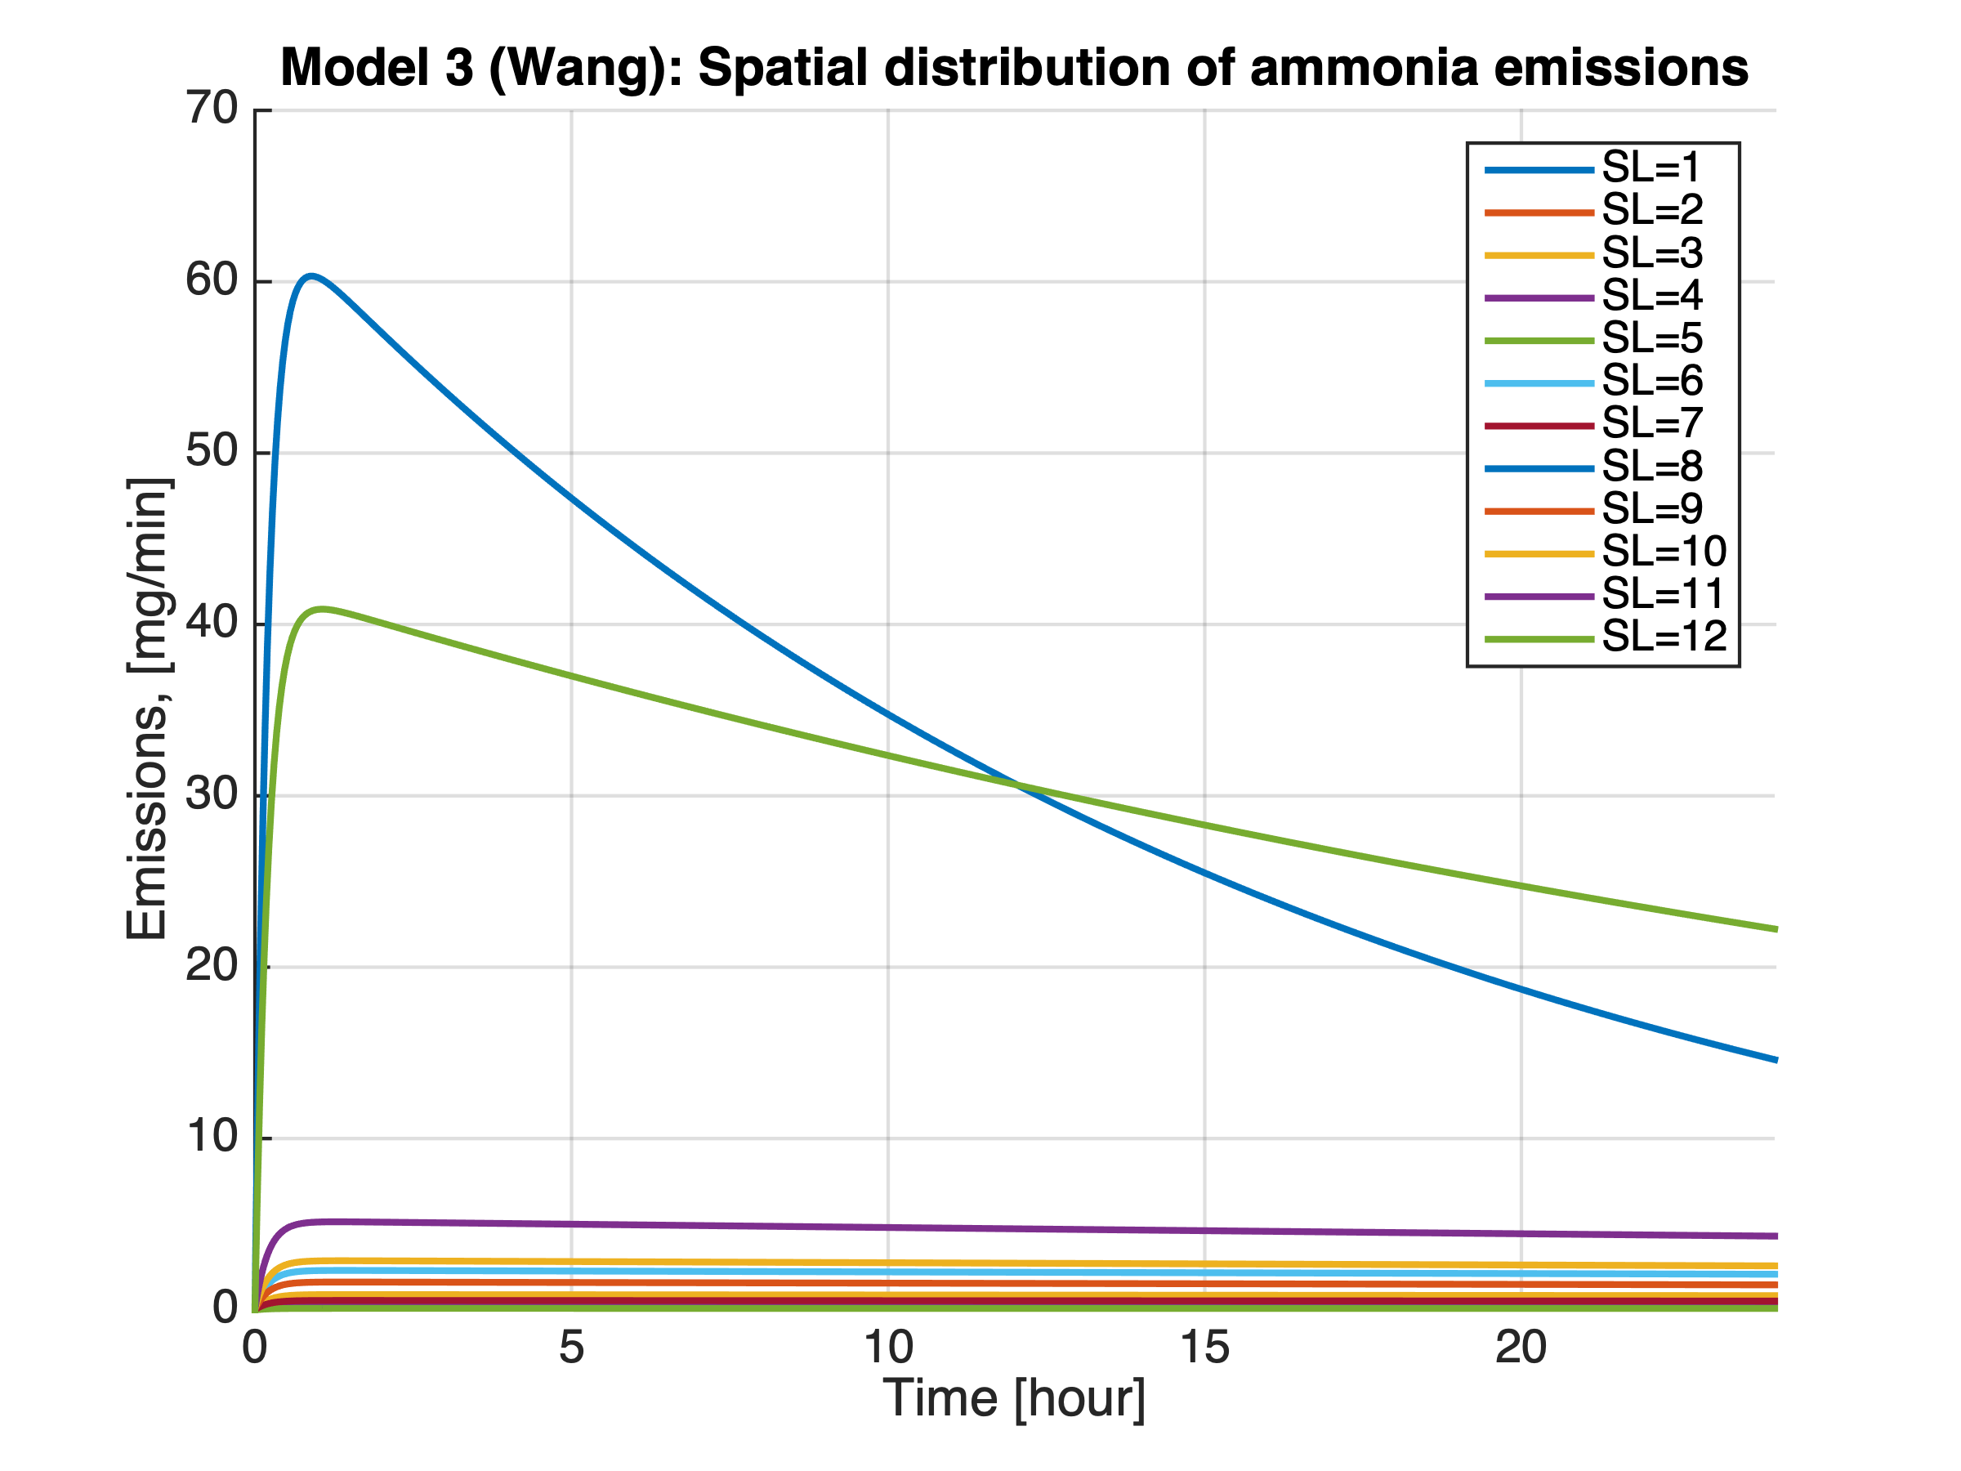
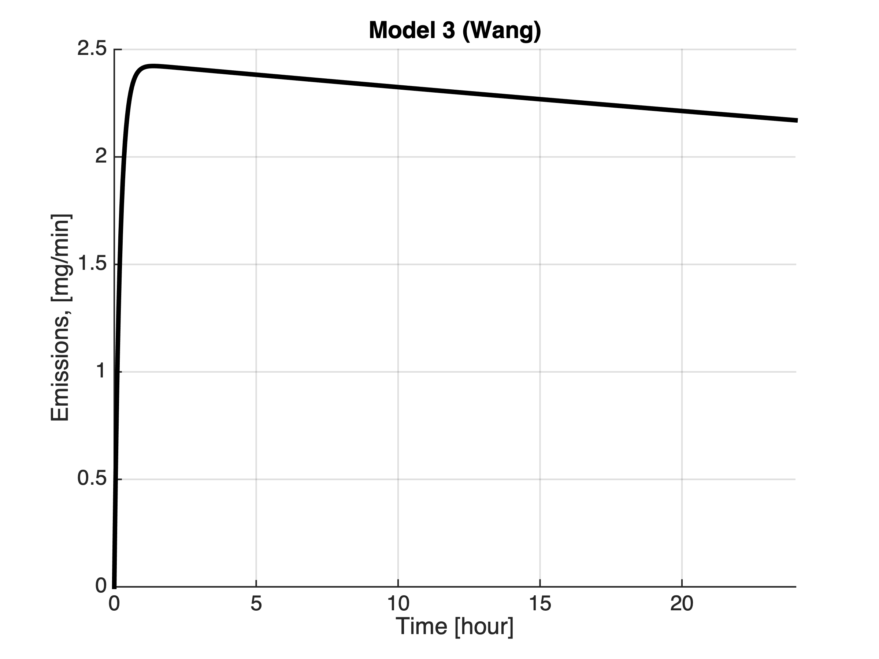
Modelling: Comparison between emissions from different models
Model 3 (Wang, Li, Zhang, 2006)
No temperature
Ammonia Emissions based on averaged ambient parametres
07.02.19
16

Slide 17
Modelling experience:
1 hour integration

Slide 19
07.02.19
19

Slide 21
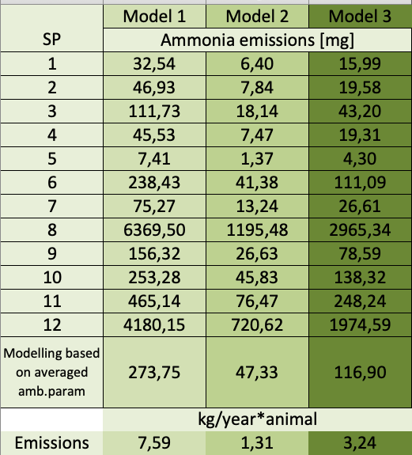
Modelling: Comparison between emissions from different models for 1 hour integration

Slide 22
Conclusion:
All three models show similar adequate distribution behavior of ammonia emissions between SP;
The emission values obtained from the model 1 are the highest, the values from the model 2 are the smallest;
The values from the model 2 are ~ 5 times smaller than for the model 1 and ~ 3 times smaller than for the model 3;
The model 1 shows the most realistic values for dairy barns (according to literature sources, f.e., Hassouna et.al., 2016...).
07.02.19
22

Slide 24
To do list:
Find the way to extend the model to the barn scale and try to add the components of housing system, playing a crucial role on ammonia emissions (floor type, scrapping periodicity and etc.);
Develop the procedure of validation, in order to identify the most appropriate model which suits our research interests.
Find the way of the most reasonable coupling method of the final emission model together with the feed intake model.
07.02.19
24

Slide 25
Opened questions for discussion:
Since models presented in Bjerg et.al, 2013 are laboratorial defined models, are they applicable to the real conditions in the dairy barn and could they be upscaled to the barn size?
How to transfer the emission model (f.e., Elzing, Monteny, 1997) estimating the values of the certain area (f.e., 1m²⁾ to the barn scale?
Where we should measure ambient parameters that they are representative for the whole barn?
How to handle the model, with the starting point at 0 time without an opportunity to introduce a new data with the certain step (every hour, two, four.. and etc.)?
07.02.19
25

Slide 26
Opened questions for discussion:
What is the source of estimation of urea concentration: urine (while urinating) or manure (from the floor)? And how different is urea concentration extracted from urine from urea concentration extracted from manure?
When the conversion speed of urea concentration stops influencing dramatically on ammonia emissions?
07.02.19
26

Slide 27
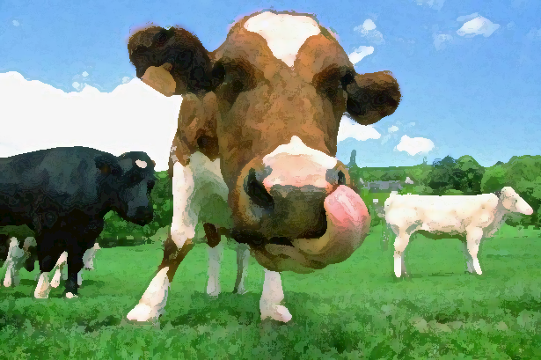
Thanks for your attention

